Slide 1
Judiciary Report
28 August 2024

Slide 2
Total reds issued - 2024
Total 2024 = 261

Slide 3
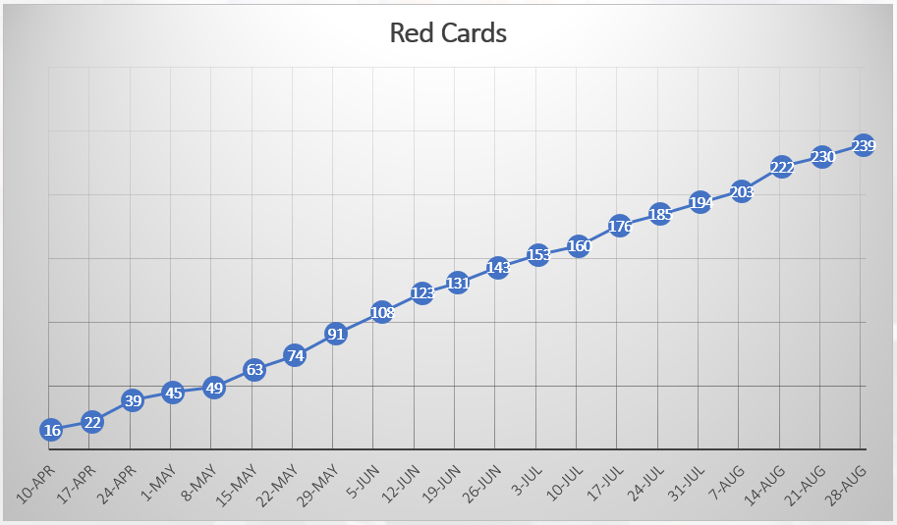
Total reds issued - 2023
Total 2023 = 239

Slide 4
Offence count
Total cards = 261

Slide 5
Club red count
Total cards = 261

Slide 6
Competition red count
Total cards = 261

